Slide 1

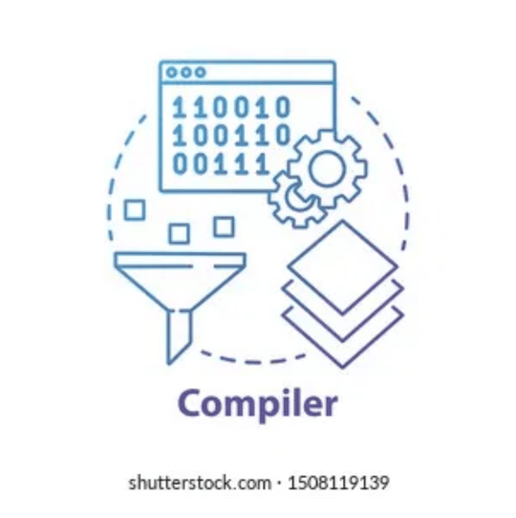
Web-Based LL(1) Parser Generator
PROJECT OVERVIEW
Interactive Educational Tool for Compiler Design Mastery
By batch 10: M. Prashamsa 2420030692
K. Shivani 2420030702
Shashivarshan 2420030570

Slide 2

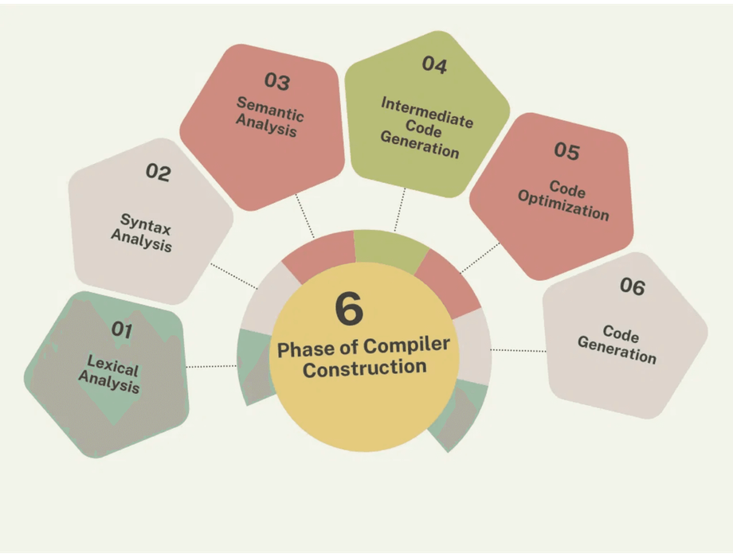
THE LEARNING CURVE IN SYNTAX ANALYSIS
Conceptual Density
FIRST/FOLLOW sets and predictive tables present abstract logic that is difficult to internalize without real-time interaction.
CHALLENGES
Manual Inefficiency
Manual parsing is time-consuming and prone to human error, which discourages student experimentation and deep exploration.
Textbooks lack dynamic feedback. Students need to see the hierarchical relationship between rules and tokens.

Slide 3
BRIDGING THEORY AND PRACTICE
⚙️
ROBUST LL(1) ENGINE
📊
AUTOMATED SETS
Implement a parsing core capable of handling complex context-free grammars with mathematical precision.
Eliminate manual errors by dynamically computing FIRST and FOLLOW sets for any given production rules.
GOALS
📋
DYNAMIC TABLES
🌳
VISUAL DERIVATION
Construct predictive parsing tables that provide immediate visual confirmation of grammar validity.
Render high-quality parse trees to visualize the hierarchical structure of processed tokens.

Slide 4



SYNERGISTIC TECH STACK
🐍 PYTHON
🌐 FLASK
The core logic engine. Handles grammar validation, set theory computations, and the stack-based parsing algorithm.
A lightweight web framework that bridges the backend logic with the interactive user interface.
STACK
👨‍💻 BOOTSTRAP
🌳 GRAPHVIZ
Ensures a professional, responsive, and accessible interface across all modern web browsers.
Dynamic visualization tool that converts parsing results into high-quality hierarchical tree diagrams.

Slide 5
THE FOUNDATION: FIRST AND FOLLOW SETS
FIRST(E) → { id, ( }
CORE LOGIC
FIRST determines which terminal can appear first in a derivation from a non-terminal.
FOLLOW(E) → { ), $ }
FOLLOW identifies which terminals may legally follow a non-terminal in a sentential form.

Slide 6
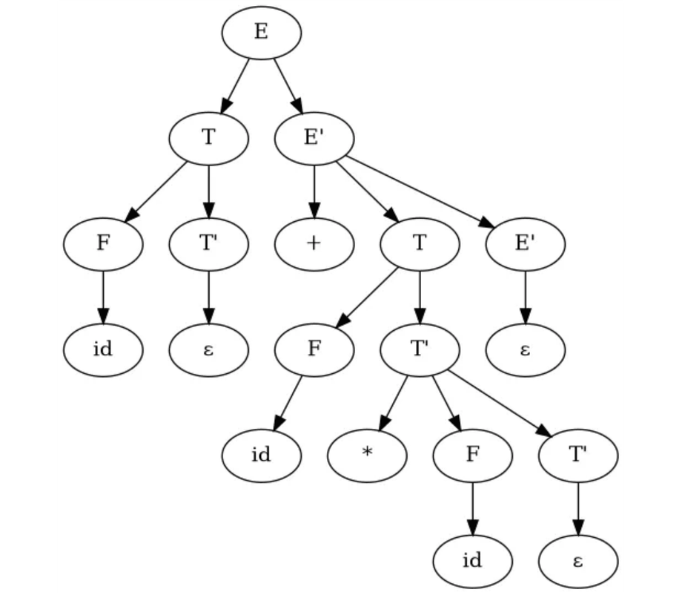
REAL-TIME FEEDBACK LOOP
📊 Set Generation
View FIRST and FOLLOW sets immediately upon grammar definition, ensuring mathematical accuracy.
FEATURES
⚙️ Stack Tracing
Follow every Match and Expand action in real-time as the parser processes tokens.
🌳 Derivation Trees
Visualize the logical hierarchy of expressions through high-quality parse trees rendered dynamically.
EXAMPLE GENERATED PARSE TREE

Slide 7
MODULAR SYSTEM FLOW
👨‍💻 USER INPUT
🌐 WEB INTERFACE
Core Engine Logic
Python handles the heavy lifting of set theory and stack-based derivations.
📄 GRAMMAR PROCESSOR
📊 FIRST & FOLLOW ENGINE
Visualization Layer
Graphviz converts internal parsing steps into high-quality hierarchical trees.
📋 PARSING TABLE
⚙️ LL(1) PARSER
Web Orchestration
Flask manages the request-response cycle between the UI and the backend.
ARCHITECTURE
🌳 TREE GENERATOR
✅ RESULT OUTPUT
🔁 (PIPELINE)

Slide 8
STREAMLINED END-TO-END WORKFLOW
👨‍💻
⚙️
🌳
✅
INPUT PHASE
PROCESSING
VISUALIZATION
DELIVERY
PROCESS
User provides expression
Compute FIRST/FOLLOW
Calculate Tree Nodes
Display Parsing Steps
→
→
→
→
Grammar rules loaded
Map Parent-Child Edges
Show Interactive Table
→
Build Parsing Table
→
→
Tokenization of input
→
Render Graphviz Image
Present Final Tree
→
Stack-Based Parse
→
→
→

Slide 9
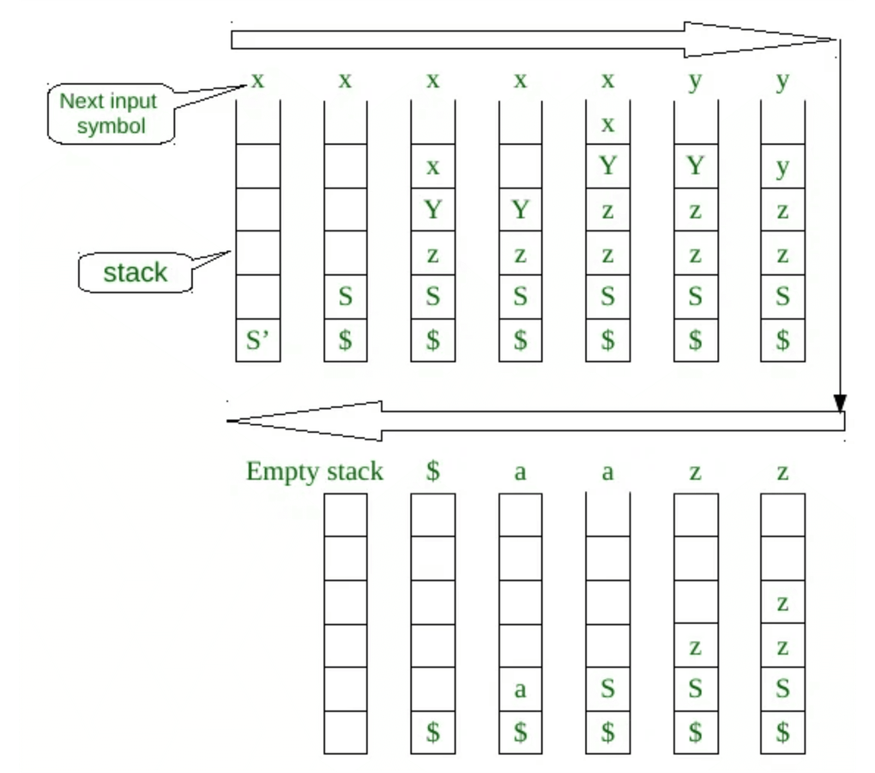
HOW LL(1) PARSING WORKS
1. Read Next Input Token
2. Inspect Top of Stack
ALGORITHM
3. Lookup Parsing Table Entry
4. Apply Production Rule
5. Match Terminal & Pop Stack
6. Accept / Reject Result

Slide 10
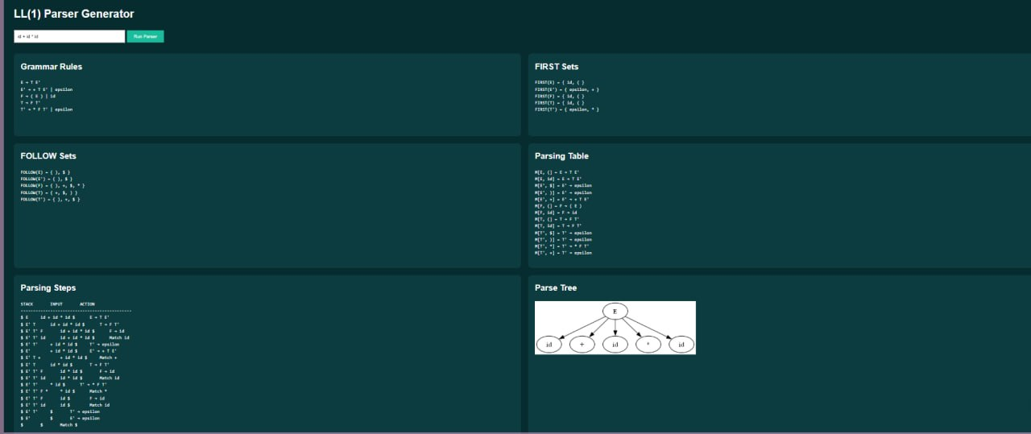

Slide 11
VISUALIZING LOGIC FOR CONCEPTUAL MASTERY
🌳 HIERARCHICAL CLARITY
👨‍💻 SHIFTING FOCUS TO HIGH-LEVEL THEORY
ADVANTAGES
Visual trees make the abstract relationship between tokens and rules immediately obvious.
By automating tedious manual calculations, the tool allows students to focus on the underlying logic of syntax analysis and grammar construction.
Students can verify their manual work against an authoritative source, eliminating the frustration of cascading errors.
🌐 ZERO-SETUP ACCESS
Web-based approach ensures experimentation without complex local configurations.

Slide 12
VERSATILE ACADEMIC APPLICATIONS
COMPILER DESIGN LABS
👨‍💻
Serves as a primary tool for practical sessions, allowing students to verify grammar validity and set computations during lab assignments.
USE CASES
CLASSROOM DEMONSTRATIONS
🌐
Provides lecturers with a dynamic visual aid to explain the step-by-step mechanics of predictive parsing and tree construction.
SYNTAX RESEARCH & SELF-STUDY
🌳
Empowers students and researchers to explore complex grammars and master the intricacies of syntax analysis at their own pace.

Slide 13
FUTURE EXPANSION AND ROADMAP
Enabling users to input and validate their own production rules for personalized experimentation.
📄
CUSTOM GRAMMARS
Extending support to LL(k), LR(0), and SLR(1) parsing modules for a broader educational scope.
⚙️
ADVANCED ALGORITHMS
ROADMAP
Providing options to save parse trees and parsing tables as high-resolution PDF or SVG files.
🌳
ENHANCED EXPORTING
Integrating lexical analysis and intermediate code generation for a complete compiler experience.
✅
FULL PIPELINE

Slide 14
THE WEB-BASED LL(1) PARSER GENERATOR SUCCESSFULLY AUTOMATES PREDICTIVE PARSING BY COMPUTING FIRST AND FOLLOW SETS, GENERATING LL(1) PARSING TABLES, VALIDATING ARITHMETIC EXPRESSIONS, AND VISUALIZING PARSE TREES.
SUMMARY
By combining Python, Flask, and Graphviz into an interactive web application, the project transforms theoretical compiler concepts into a practical learning experience.

